Slide 1
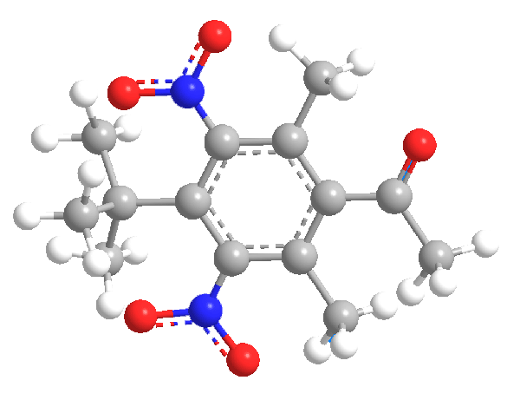
Chemical
Classification
Musk OR Non-Musk

Slide 2
Table of Contents
01
02
Problem
Analysis
03
04
Create model
Test & Save
Chemical classification
What data is ?
How to measure ? etc
Created with ANN
Testing with data
Validation accuracy & loss

Slide 3
Introduction
The given dataset contains details about organic chemical compounds including their chemical features, isomeric conformation, names and the classes in which they are classified. The compounds are classified as either ‘Musk’ or ‘Non-Musk’ compounds. Your task is to build a classification model on the given data using any Deep Learning approach that you deem appropriate viz. Multi-Layer Perceptron, CNN, RNN, etc. or you could also use transfer learning approaches through selection of appropriate pre-trained model. The data has to be split in a 80:20 ratio for training and validation datasets. You can perform whatever preprocessing and post-processing operations on the data that may help you improve the performance of your model. You are required to report the performance measures of the model viz. Accuracy( Training and Validation) and Loss(Training and Validation) graphs, F1 score, precision, recall, etc. along with a well detailed report of what models, pre-processing, post-processing approaches you have used and why you chose to use these approaches.

Slide 4

Made in for this Company
Credicxo
We at Credicxo provide immediate monetary support to our customers in the form of instant Personal Loan with hassle-free processing and swift approval. Credicxo provides financial support to ambitious Entrepreneurs, Students, Salaried and Self-employed individuals. The eligibility assessment is nominal and we provide our service 24x7 with instant approval and quick disbursal.
Simple Swift Money

Slide 5

About Me
Kushal Dulani
Computer science Engineer
Mobile : +91 777-88-222-89
dulanikushal@gmail.com

Slide 6
Work Process
Analysis
Creating classifier
Training
Testing & Deploy

Slide 7
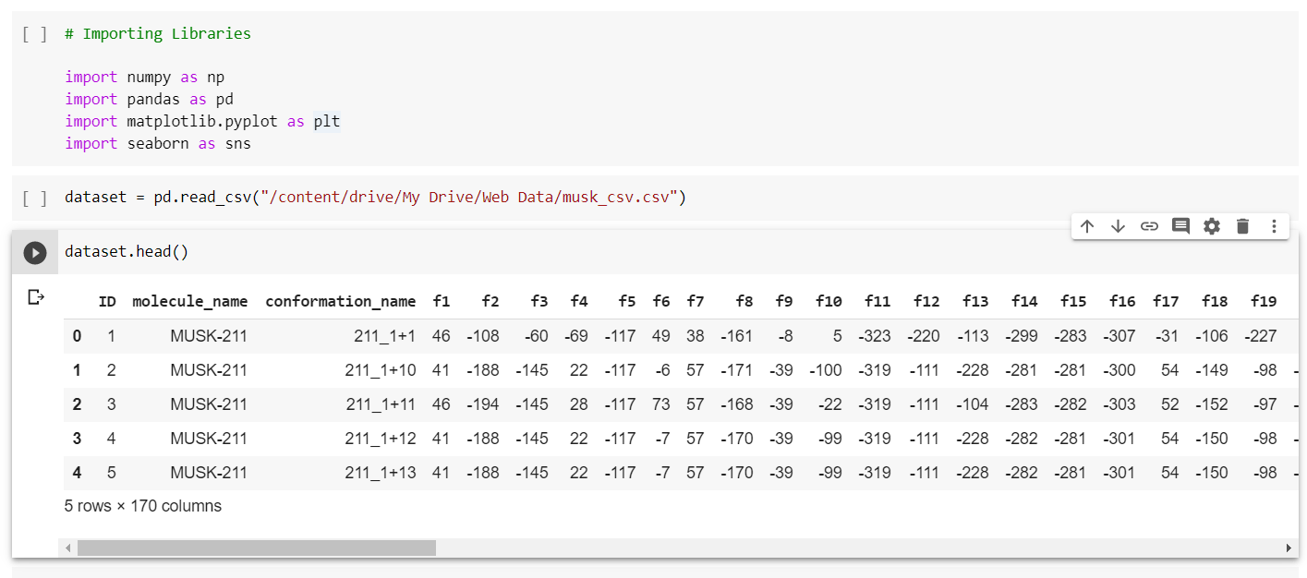
Code Demo

Slide 8
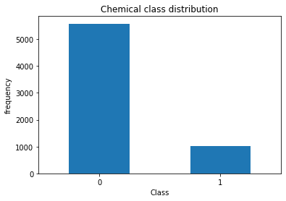
Analysis
6597 Total
1017 Musk
5581 Non Musk
There are 6597 total chemicals

Slide 9
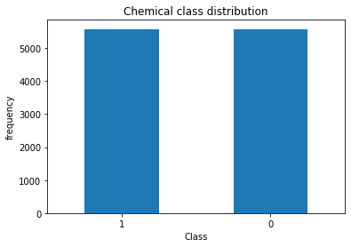
Analysis
11162 Total
5581 Musk
5581 Non Musk
Data Balancing
Combine Sampling Method

Slide 10
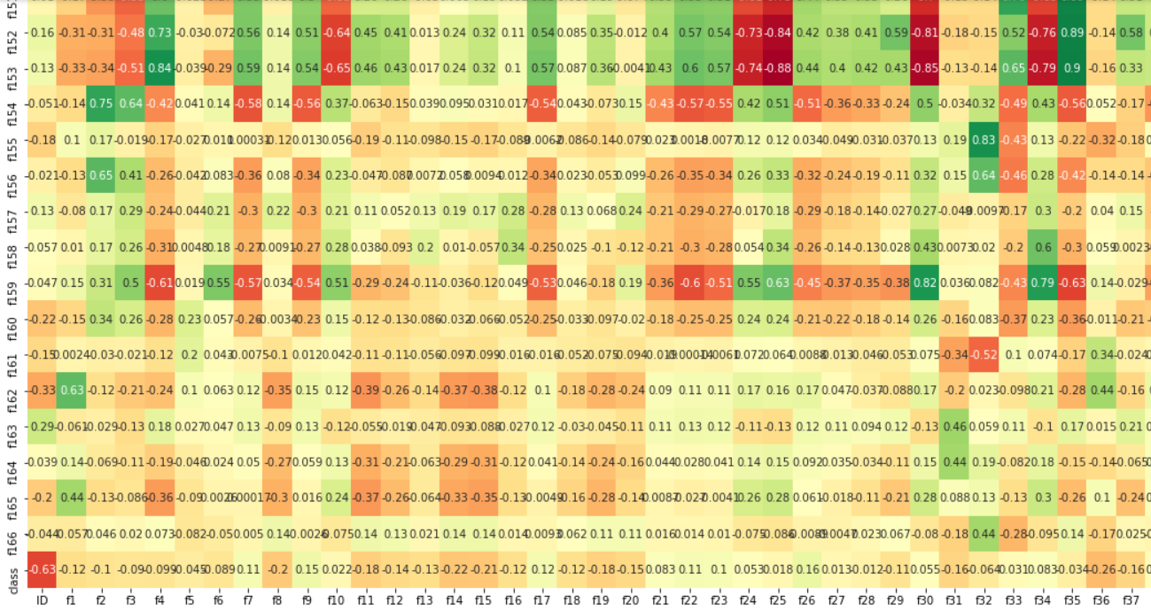
Samples of Heatmap

Slide 11
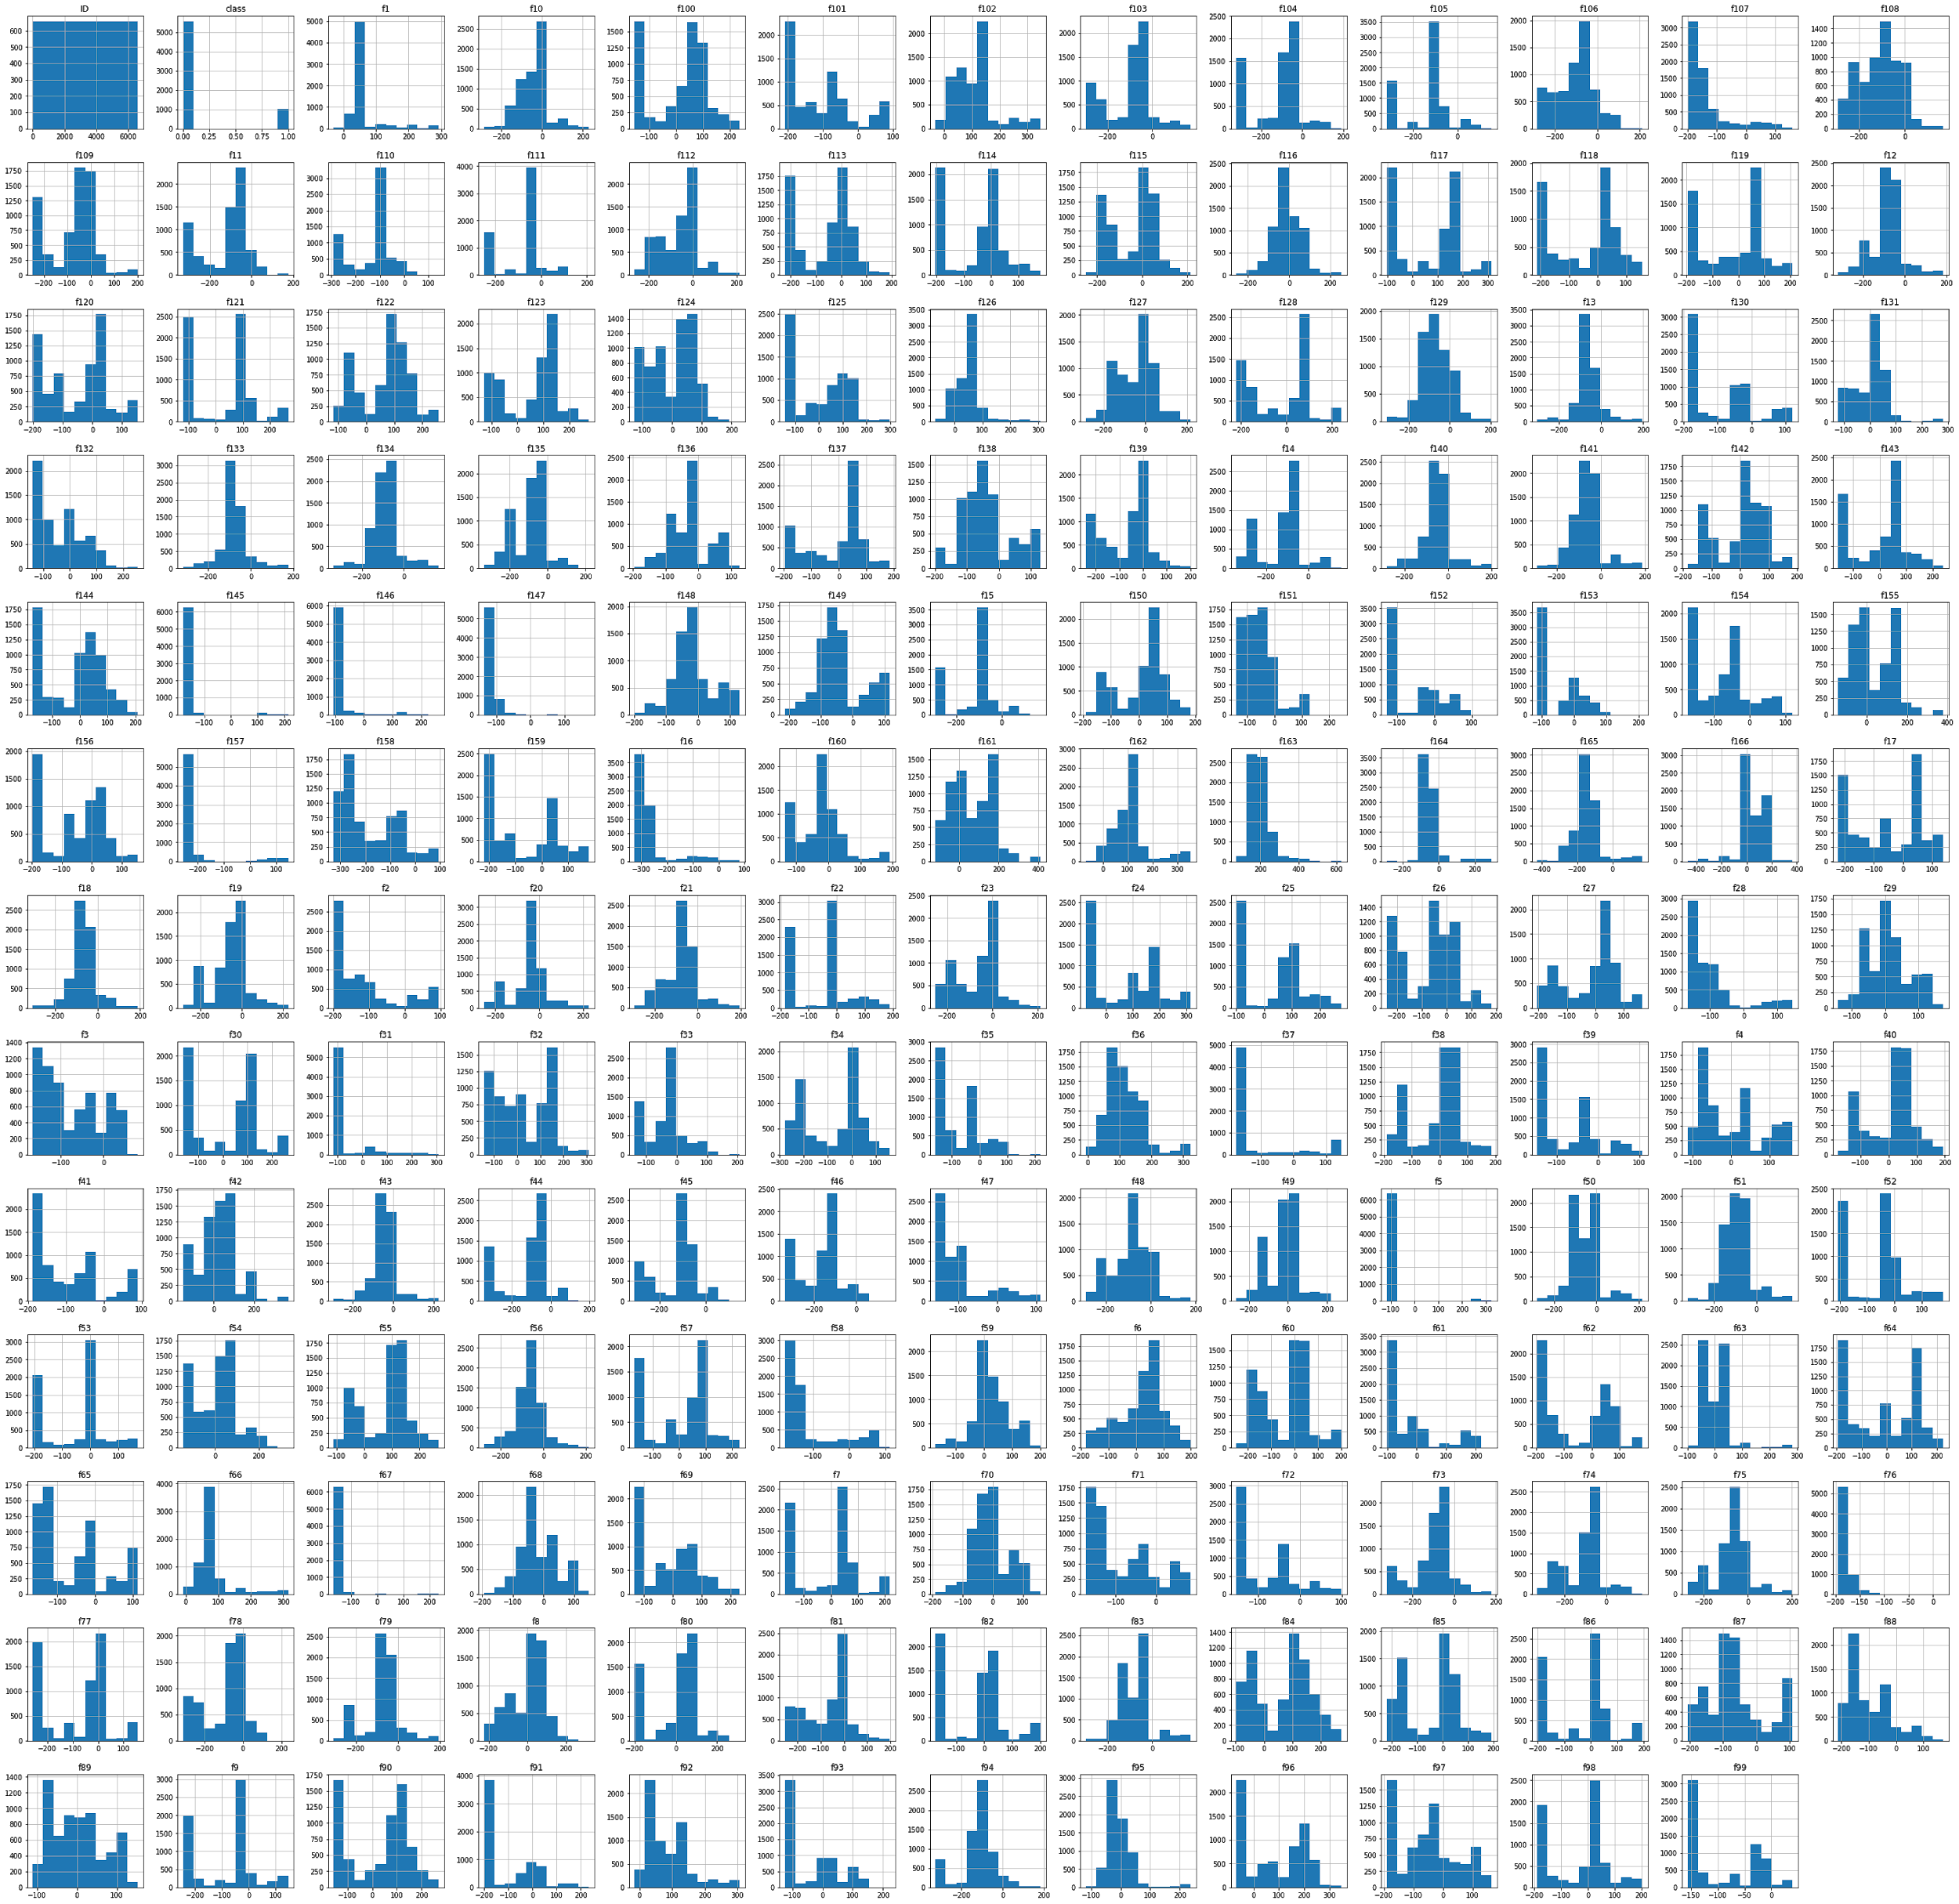
Samples of Histogram

Slide 12
Work Flow
Splitting Train / Test
Scaling Variables
Model
Used sklearn.model_selection import train_test_split
Used sklearn.preprocessing import standardscaler
Used keras,fit into it and test it

Slide 13
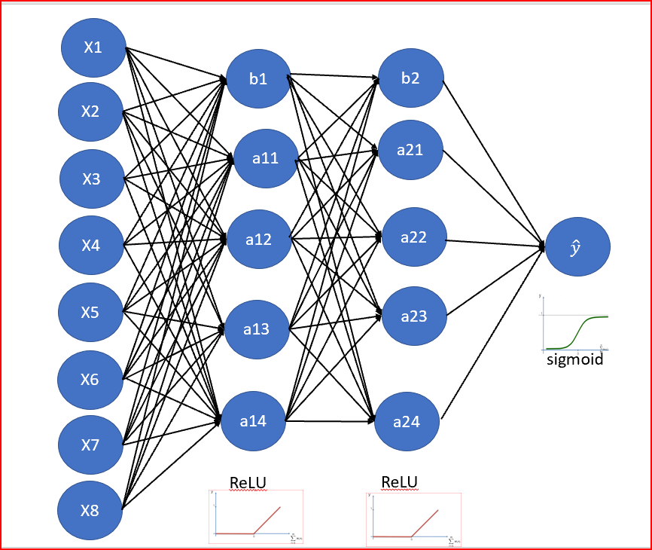
Accuracy
batch_size=40,epochs=246
batch_size=10,epochs=893
95.32%
99.14%

Slide 14
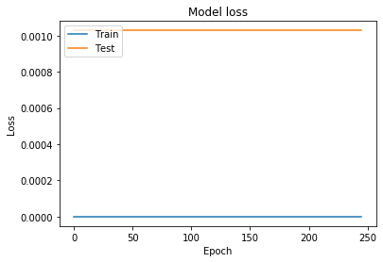
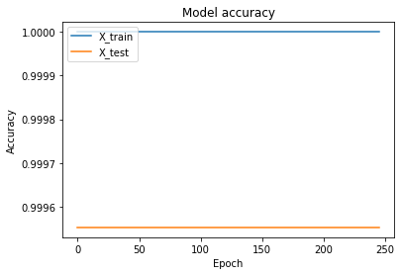
Training & Validation

Slide 15
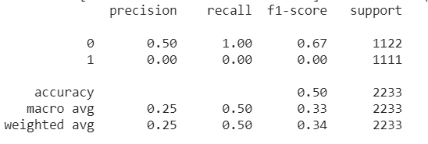
Recall & F-1 Score

Slide 16
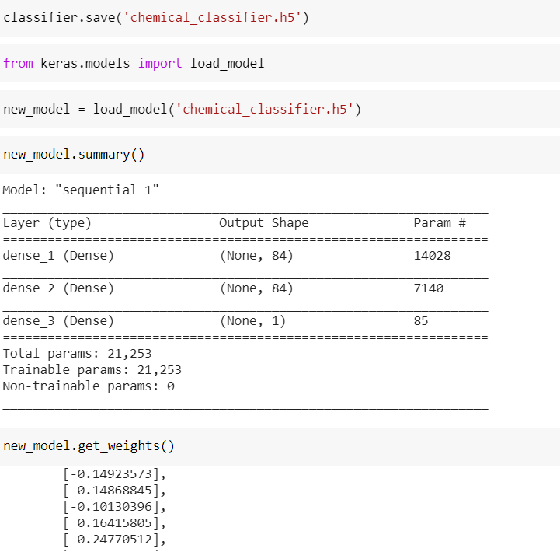
H5 model trained

Slide 17


Used For Development & upload

Slide 18
Thank You

